Slide 1
Sampling Methods
Notes:
Title page:
Font size 36, bold, theme color of the chapter (red for geometry, blue for algebra, green for statistics)

Slide 2
Before conducting a survey, the objectives and the target group of the survey must be clearly identified. The whole target group is called the population of the survey.
For example, if a teacher wants to know the average height of S6 students in a school, then the population is all S6 students in the school.
The teacher can collect data from every S6 students in the school to find the average height,
or collect data from only some S6 students in the school to estimate the average height.

Slide 3
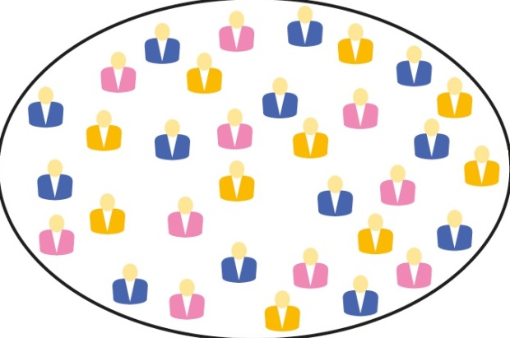



The two methods stated in the previous example are known as
census
and sample survey.
A census collects data from every member of the population.
A sample survey collects data from a sample which contains only some members of the population selected by a sampling method.
Sampling
method
Sample
Population

Slide 4
Follow-up question
The owner of a nursing house wants to collect their residents' opinions on the meals provided. He interviewed 20 residents in the nursing house. Identify the population and the sample from the groups on the right column.
• all nursing house residents in Hong Kong
Population •
• the 20 residents interviewed
Sample •
• All residents in the nursing house

Slide 5
In some cases, collecting data from every member of the large target group,
is not practical because of cost,
i.e. the population,
time
and other considerations.
For example, a researcher wants to find the average height of all Chinese male adults. Clearly, it is impractical for him to measure the heights of all the members of the population.

Slide 6

A representative sample is a sample that can reflect the characteristics of the population.
Therefore, he may select a sample of Chinese male adults and measure the heights of male adults in this sample.
Average height of all members in the population
Average height of all members in the sample
cm
200
150
100
Population
Representative sample
If the sample is representative, the average height obtained from the sample would be a good estimate of the average height of all Chinese male adults.

Slide 7


How can we choose a representative sample?
There are different sampling methods to collect a representative sample.

Slide 8
There are two main types of sampling methods:
Sampling Methods
Non-probability Sampling
(Non-random Sampling)
Probability Sampling
(Random Sampling)
(does NOT involve random selection)
(involves random selection)
The probability of the members being selected into the sample is unknown.
The sample is selected entirely by chance. Each member in the population has a known probability of being selected into the sample.

Slide 9

Non-probability Sampling
Some common non-probability sampling methods are provided below.
(a) Convenience sampling
A sample is chosen from the members of the population which can be accessed easily.
For example, a reporter wants to collect public opinion about the increase in bus fare. He picks people on the street and asks for their opinions on the issue.

Slide 10

(b) Voluntary response sampling
In this type of sampling, members of the population can decide whether to be included in the sample or not.
An example is online voting which invite people to vote on certain topics. People can vote and express their opinions voluntarily.
Although non-probability sampling is quick and easy to conduct,
the samples obtained may not be representative and may give biased results.

Slide 11
Probability Sampling
Three commonly-used probability sampling methods are: simple random sampling,
and
stratified random sampling.
systematic sampling
Simple Random Sampling
In simple random sampling, every member of the population has exactly the same chance of being selected into the sample.

Slide 12
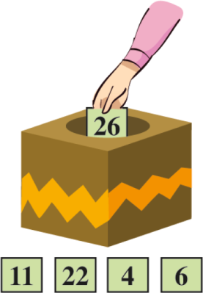
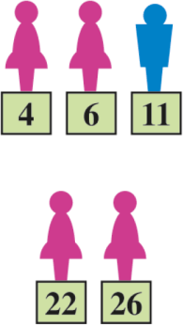
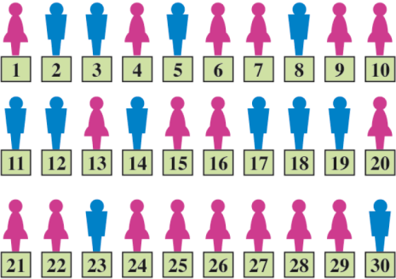
For example, a teacher wants to investigate the weekly time spent on sports by 30 students. A sample of 5 students can be selected by simple random sampling as follows:
3. The 5 students with the assigned numbers matching the randomly selected numbers are included in the sample.
1. Assign a unique number to each student.
2. Draw 5 numbers from all the assigned numbers.
One of the advantage of this sampling method is its relative simplicity.
However, it requires a complete listing of the members of the population.
In some cases, such listing may be difficult or expensive to obtain.

Slide 13
Systematic Sampling
In systematic sampling, the population is arranged in order in a certain way.
First, a starting point is randomly selected in the population.
Then, members are selected at regular intervals to form the sample.
Referring to the previous example, a sample of 5 students can be chosen from 30 students by systematic sampling as shown in the following:

Slide 14
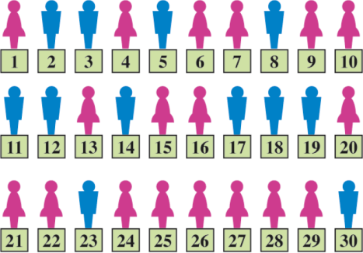
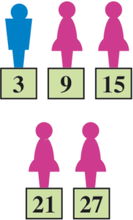
1. All students are arranged in order.
2.
Since 6 ,
3. The sample contains the 3rd, 9th, 15th, 21st and 27th students.
a first number is randomly chosen between 1 and 6, say 3.
Then, the 3rd student of every 6 students is selected.
This sampling method is less time consuming and less expensive
because the sample can be obtained by just picking one random number.
It also ensures that the sample is evenly selected across the population.
However, if some patterns occur repeatedly at regular intervals among the members, this sampling method is not suitable.

Slide 15
Stratified Random Sampling
In stratified random sampling, the population is divided into several sub-groups called strata.
Each sub-group has its own characteristics.
All members of a stratum share a common property which other strata do not have. Therefore, each member can only fall into one stratum.
Stratum is the singular form of strata.
Because of this, a representative sample should include members from all sub-groups, and in numbers in proportion to the sizes of the sub-groups.
Referring to the previous example, a sample of 5 students can be chosen from 30 students by stratified random sampling according to gender as shown in the following:

Slide 16
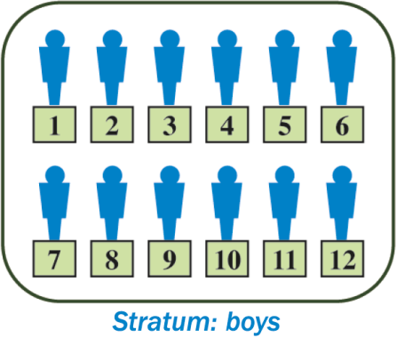
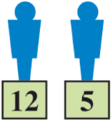
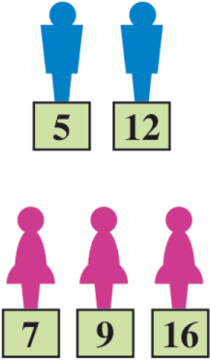
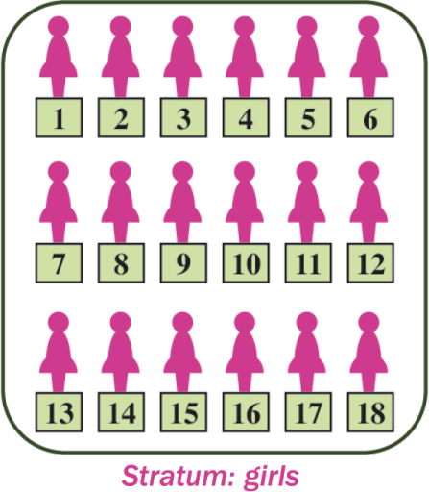
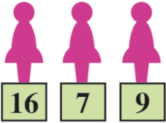
2.
Ratio of boys to girls in the sample
= ratio of boys to girls in
the population
= 12 : 18
= 2 : 3
Therefore, select 2 boys and 3 girls randomly.
3. A sample of 2 boys and 3 girls is selected.
1. 30 students are divided into two strata (12 boys and 18 girls).

Slide 17


This sampling method is likely to give a representative result.
It ensures that we can obtain a sufficient sample size from each group
even if some groups are very small.
However, taking samples from each stratum is more time consuming and more expensive, and the analysis is more complicated.

Slide 18
Follow-up question
In each of the following cases, identify the sampling methods used.
(a) In a factory, the 17th light bulb of every 50 light bulbs produced is selected for quality check.
(b) In a fast food shop, questionnaires are placed on each table. Customers can fill in the questionnaires voluntarily to comment on the variety of food provided.
Systematic sampling
Voluntary response sampling

Slide 19
Follow-up question (Cont.)
In each of the following cases, identify the sampling methods used.
(c) In a school, 10% of students in each form are selected at random for a study on their favourite snacks.
(d) Choose the first 10 luggage in a luggage conveyer for security check.
Stratified random sampling
Convenience sampling

